Slide 1



May 2025
SERVING THE COMMUNITIES OF ACTON BURNELL, PITCHFORD, FRODESLEY, RUCKLEY AND LANGLEY
WELCOME
SOMETHING TO DONATE?
If you’ve sorted through your summer wardrobe and decided some old favourites are no longer quite ‘you’, then you might consider donating to Leukaemia and Myeloma Research. A clothing bank has just been installed at Dorrington Village Hall, so please pop along with any clothes or shoes and pass them on to this worthwhile charity to help with their fundraising.
As summer rolls around again, we are keeping our fingers crossed for good weather for the annual Acton Burnell Fete and Bash. If you have time to spare and would like to get involved in this fun-filled local event, please take time to read the short article about the Fete and get in touch with Jill Faulkner to offer your assistance.
We are also looking for a volunteer to help with the production of Village Views. If you have experience in graphic design or would like to develop your design skills, and if you can spare a couple of days every three months to put together Village Views ready to go to print, we would love to hear from you. There is no writing or editing involved.
Contact villageviews@hotmail.com to arrange a chat!
Chris Harrison, Karen Fisher,
John Glover, Rachel and Lois Johnson
CONGRATULATIONS TO FRIENDS OF THE FOX!
It's finally happened!
The Friends of The Fox at Ryton have completed on the purchase of The Fox Inn. Chair, David Oliver, enthused “Having reached the minimum target for the Community Share Offer (new total: £157,000 as of 12/4/25) and received the £299,300 grant from the Communities Ownership Fund we are now ready to start the renovation and refurbishment. The dream is becoming a reality”
He said that this was only the beginning. The Community Share Offer has now closed and the money raised would enable the further enhancement to create a community pub and café that we can all be proud of.
Plans for the pub are being progressed and builders lined up for the renovations including a new roof , kitchen reconfiguring and first floor accommodation upgrade. Progress will be shared via social media.
Secretary Helen May added that “a series of events will be held including fundraising events and public meetings to continue with consultation on the plans to renovate and reopen The Fox.”
An event has already taken place on Saturday 5th April where up to 120 local villagers and shareholders turned up for drinks and a tour of the pub. There was subsequently a great article and photo in The Shropshire Star.
Vice Chair, David Thorpe commented “during this next phase of the project, we will be planning the design and
layout to The Fox. We have already seen some really great ideas; however, the scope of works will be very much dependant on the level of share investment.”
Further offers of support are coming in all of the time. Thank you to everyone who has bought a share, volunteered skills and materials, raised money at our fundraising events, spread the word and given time and effort to the campaign – truly a team effort!
To follow the story of our new community pub and cafe and hear about events, fundraisers and how to volunteer please go to: Facebook The Friends of the Fox, Ryton, Instagram @friendsofthefoxinn or visit our website www.the-fox-at-ryton.co.uk.
Dave Wright, Friends of the Fox Committee
Peat-Free Compost Topsoil
Bark Mulch Woodchip
Locally produced in Shropshire.
Loose and bagged – delivery and collection available
www.carbonearth.co.uk
Call 01743 821226 / 07935293225
or email products@carbonearth.co.uk
ACTON BURNELL FETE AND BASH
We are changing the format slightly this year. The fete will be held on Saturday 5th July 2025, commencing at 3pm and running until around 5pm when we hope to start serving a bar-b-que (ticket prices to be announced nearer the date).
A bar will be available for the afternoon and evening, ably run by Brian and Sarah - what would we do without their help and support!
There will be a variety of stalls and sideshows including teas, ice creams, cakes and a bottle tombola.
If anyone has any ideas for sideshows or knows of someone who has crafts or produce for sale and would like a stall for a small fee, please get in touch with jillfaulkner@btconnect.com
Any offers of help will be greatly appreciated so please come along and get involved and enjoy a local community event.
Jill Faulkner
The closing date for contributions to the next edition will be 19 July 2025.
Please contact villageviews@hotmail.com with any news or villageviewsadvertising@outlook.com to place an advert.

Slide 2


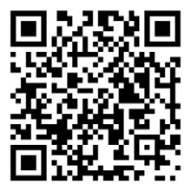

COUND AND DISTRICT TENNIS CLUB
COME AND JOIN IN OUR FUN AND SOCIAL TENNIS COMMUNITY
https://clubspark.lta.org.uk/coundanddistricttennisclub
or use our Cound and District Tennis Club Homepage QR Code
For membership enquiries please contact us at
membershipatcound@btinternet.com
FUTURE CLUB EVENTS
18th May French Open Fun Grand Slam Social Event: 2pm - 5pm
8th June Summer Family Fun Day: 11am: 3pm
29th June Wimbledon Fun Grand Slam Social Event: 2pm - 5pm
13th July Wenlock Olympics Tournament Juniors & Adults: 10am - 4pm
Adult beginners courses, adults drills and cardio, Juniors Saturday coaching and private lessons
Please contact Club Coach Graham Hart on 07960 970 017 or
email hartg734@aol.com
PVH VOLUNTEER CAMPAIGN
      Pitchford Village Hall has
      been part of our
      community for nearly
      100 years. During this
      time, It has been managed
      by volunteers and used by
      the local community for
      family events,
      neighbourhood
      get-togethers, charity
      fundraisers, election
      polls, training events,
      fitness classes,
      professional meetings and many many other things!
      The team at PVH are inviting members of the community to support the PVH charity by joining our ‘Do One Thing’ campaign. We are asking friends and neighbours to join us in looking after the Hall and ensuring its continuity by volunteering to ‘do one thing’ for the Hall this year.
We will be collating a list of activities that you can volunteer to do…ranging from pulling pints to decorating the Christmas tree. We are hopeful that there is something for everyone and that we can make the most of the skills , experience and generosity that we have in the community.
You don’t need to commit to do anything long term or get involved with the committee meetings and paperwork (unless you want to of course!). So take a look at some of the example tasks below, and look out for updates on our Facebook and Instagram pages. We will also display information on the notice board at the Hall.
It would be great if, by ‘doing one thing’ for PVH this year, we can bring the community together, meet more people and widen our network of friends, neighbours and helpers.
This could also be a good opportunity for CV building, Duke of Edinburgh Award activities and using a paid a ‘volunteer day’ if you are lucky enough to have them.
If you are interested in getting involved or want to share about any ideas you may have please get in touch with us via social media, or email Miriam direct at miriamdavies@hotmail.co.uk.
Pull a pint or two behind the bar at Pub Night
Write a review on our Facebook Page
Use your green fingers to trim our hedges or cut the grass
Hire the hall for your next meeting or event
Flip some eggs and make some brews at our next Breakfast butties event
Decorate the Christmas tree and string up some tinsel at Christmas time
Recommend the Hall to a friend
Show off your DIY skills and help us with ad-hoc repairs and decorating
Share your ideas for community events and fundraisers
Signposts us to any food vendors you might know, who may want to join us at Pub Night
Give some time and bring your duster to our big Spring clean
Bring your tech savvy skills and help us build a website

Slide 3

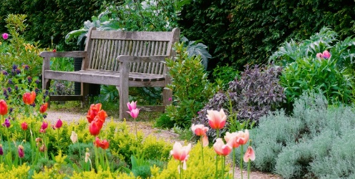
What’s On
SUMMER IN THE GARDEN
The National Garden Scheme has a number of gardens open to the public in our area this summer. Among those throwing open their garden gates for everyone to enjoy are Court Acre and The Bramleys at Condover (4th May), Longden Manor at Plealey (11th May), The Leasowes at Cound (17th May) and Preen Manor at Church Preen (15th June). Go to https://findagarden.ngs.org.uk for more information, including details on opening hours and tickets.
Thanks to the generosity of garden owners, volunteers and visitors the NGS donated over £63 million to nursing and health charities, and in 2021 donated over £3 million. Beneficiaries include Macmillan Cancer Support, Marie Curie, Hospice UK and The Queen’s Nursing Institute.
Friday 9th May
Pitchford Village Hall marks the 80th Anniversary of VE Day with a special themed Pub Night featuring music from the 1940s and a wartime-inspired corned beef hash, and the usual choice of beer, wine and soft drinks. Cash payments only, please. Doors open at 7.30pm. As always, children and well-behaved dogs very welcome.
Saturday 10th and Sunday 11th May
Shrewsbury Regatta sees competitive rowers from across the country gathering to test their skills and speed. Competitions for 8s, 4s and pairs as well as quad, double and single sculls will be racing across both days from 9am to 4pm. Watch the races for free from the riverside paths at The Quarry, Shrewsbury and on the boathouse side of the river. Bar and barbecue available throughout both days.
Sunday 11th May
VE Day celebrations at Ryton Village
Hall with tea, cakes and fizz from 2pm to 4.30pm.
Friday 16th May
Wine tasting evening in support of The Friends of the Fox at Ryton Village Hall. Tickets available from Chrissie on
07506 845928.
Tuesday 20th May
Annual Parish Meeting will be held at Pitchford Village Hall at 7.30pm. All residents from Acton Burnell,
Frodesley, Pitchford, Langley and Ruckley are welcome to come along to hear an update on the work of the Parish Council over the past 12 months, in addition to presentations from some interesting local organisations. Take
the opportunity to ask questions and offer comments and ideas. Refreshments provided.
Saturday 24th May
Shropshire’s farmers and countryside enthusiasts take centre stage again at the Shropshire Agricultural Show at the West Mid Showground, Shrewsbury. Everything from livestock and tractors to birds of prey and monster trucks will be on display, with exciting entertainment in the main arena, and a wide range of stalls and food outlets. Live music throughout the day to help things go with a swing. Go to www.shropshirecountyshow.com/about-us/ for more information and to order tickets.
Friday 13th June
Pub Night at Pitchford Village Hall comes around again. Join your neighbours and friends for a pint or a cheeky glass of wine, and a chinwag. Drinks on sale from 7.30pm.
Friday 13th June
Dance Anthem Orchestra performing at Attingham Park, with an evening of dance classics from the last 40 years. Food and drink on sale throughout the evening. Come along and boogie down from 5.30pm to 10.00pm. Tickets on sale from Eventbrite.co.uk.
Saturday 14th June
Proms in the Park at Attingham Hall from 5.30pm to 10.00pm. Classical music familiar from TV, film and theatre under the stars. Bars and street food to help the evening go with a swing. Booking essential via www.Eventbrite.co.uk.
Saturday 28th June
Breakfast Butties at Pitchford Village Hall, with the option of a pleasant guided stroll around the nearby countryside to help work up an appetite! Doors open at 9.30am; serving until 12.30pm.
Saturday 5th July
The much-anticipated and always entertaining Acton Burnell Fete and Bash will be held in the grounds beside the church. Stalls, sideshows and refreshments from 3pm, followed by a barbecue from around 5pm (ticket prices to be announced nearer the date). Come along for some good old-fashioned fun and help to raise funds for the upkeep of our beautiful church.
Friday 11th July
Where better to spend a summer evening than having a chat and a drink at Pitchford Village Hall? Come along from 7.30pm for an evening of chat and banter with friends and neighbours. Children, dogs and well-behaved adults all welcome!
Saturday 12th July
Attingham Dining Club offers an afternoon of great food and drink from a wide range of street food vendors at Attingham Park. Begins at 12 noon and finishes at 6.00pm. Children and four-legged friends welcome.
Tickets available from https://digbethdiningclub.com/event/attingham-dining-club.
Saturday 19th and Sunday 20th July
The Dragon Boats are back on the River Severn at The Quarry Park, Shrewsbury, for the annual fund raising races for Severn Hospice. Pop along to spectate for free from the footpaths along the river or put together a team to race. All slots for Saturday are already sold out, but some still remained for Sunday as we went to press. To apply, or for more information, go to https://events.severnhospice.org.uk/events/details?eid=EVTDRA25
COUNTRYSIDE CODE REMINDERS
Most of us who are lucky enough to live in beautiful Shropshire are well aware that the countryside is also the workplace for numerous farmers and smallholders, and that access to the land means keeping to a few simple rules. Visitors, holiday makers and day trippers may not be so well informed, so just as a quick reminder of the Countryside Code, here are the main points!
Be considerate to those living in, working in and enjoying the countryside.
Leave gates and property as you find them.
Do not block access to gateways or driveways
when parking.
Be nice, say hello, share the space.
Follow local signs and keep to marked paths unless wider access is available.
One local farmer has, unfortunately, had to retrieve his cattle from adjoining land when gates were left open. It goes without saying that where livestock is grazing (or where it is possible that livestock may be about) it is important to keep dogs under close control – which for most of us will mean keeping them on a lead, unless you are 100% sure your dog will come straight back when called.

Slide 4
NEWS FROM MUCH WENLOCK AND CRESSAGE MEDICAL PRACTICE
PRACTICE BANK HOLIDAY CLOSURES
The practice will be closed Monday 5th May and Monday 26th May. Should you need urgent care during this time, please contact 111.
CARER CONNECT
Carer Connect is an all-inclusive community group. It provides an opportunity to meet others and to connect with the support services available to you in the local community.
The group meets on the first Tuesday of the month at Priory Hall, Much Wenlock, from 2pm until 4pm. Sessions are Dementia Friendly, supported by Julie Rose from the Alzheimer's Society. Refreshments are provided and there are a variety of activities throughout the year.
For more information, please contact
Jo Weaver-Jackson on 01746 551137 or joanne.weaver-jackson@nhs.net.
The next Carer Connect meeting will be held on the 6th May where the AB Ukuele Band will be playing.
COMPASSIONATE COMMUNITIES (COCO)
Due to increased demand, we need more CoCo volunteers to provide companionship and a willingness to help people in practical ways. This could be helping with paperwork, collecting prescriptions, shopping together, befriending, walking a dog or feeding a cat; anything that the person and their volunteer agree might be helpful.
If you are able to support someone in the community, please contact the surgery for more information on
01952 726011.
DISPENSARY INFORMATION
To all our dispensing patients, many thanks for your ongoing support in using our Dispensary service and therefore enabling us to continue providing your medications directly and locally. We have recently completed a patient satisfaction survey and as part of that sought feedback for the service. The results were resoundingly positive and certainly reflect the hard work and dedication of our dispensary team. To just pick up on a few points:
Opening hours: The Dispensary is open from 08:30am – 1pm and 2pm – 6pm Monday to Friday. At present we are unable to open between 1-2pm due to staffing numbers in reception and Dispensary, as both need a dedicated lunch break, and we are unable to allow lone working due to the safety and protection of our staff. We appreciate that this may be an inconvenience in access and in future should we have staffing capacity we will review things.
28 Day Prescribing: The Gold Standard in terms of prescribing is to issue 28 days at a time, however we appreciate that this may be an inconvenience in terms of requesting your medication so regularly. As our Dispensary is a small space, we are unable to hold large amounts of drug stock, which limits how much we can distribute at a time, and we are understandably keen to minimise any waste due to drug expiry. We have a system of Automatic Prescribing, which essentially automatically generates your prescription without you needing to request it, being prepared by our team and you simply contacted when needing to collect. This is obviously best used for those on established medications which are not likely to change. If you would like to have this service, please get in touch.
Holidays: If you are planning to be away for a period of time, we can easily arrange for you to have medication to cover that period. When this is the case, just let our dispensary team know with some notice and they will facilitate prescriptions to cover the time you need.
We want to again thank you for using the Dispensary, as it is only in keeping it well utilised that we are able to maintain the service. We also want to thank you for your kind words regarding our Dispensary Team, who are a very dedicated group and are very appreciative of your positive feedback.
Request for a Volunteer
Pitchford Parish Councillor
A NASTY NIFF?
There have been some recent incidents involving blocked sewer pipes in our area, and Severn Trent have issued advice on what to do to both prevent and deal with any future ‘unpleasantness’!
Sewer blockages can cause a clogged kitchen sink, problems with flushing toilets, bad smells from pipes and drains, and, in the worst cases, sewage flooding homes and gardens. Steps that we can all take to avoid this happening include not putting things like wet wipes, cotton buds, dental floss or nappies down the toilet, and not washing oils, fats and grease down the sink (scrape used oils and fats into a container and then put it in your household waste bin). Severn Trent advice using a sink strainer to catch any leftover food that may end up in the sink.
If there is a problem with your drains, please call Severn Trent’s 24 hour help line on 0800 783444.
Local elections were held on May 1st and our Shropshire councillor for Burnell Ward has been elected. Parish Council elections for the county were held on the same day. However, you will have noted that there were no elections for our combined parish; Acton Burnell, Frodesley, Pitchford, Ruckley & Langley. This is because the Parish Council posts (four for Acton Burnell, two for Pitchford, two for Frodesley and one for Ruckley & Langley) were uncontested. Parish Councillors will therefore remain as before except that Tracy Johnson, representing Pitchford, has decided to stand down, leaving Pitchford with only one representative, Alan Hotchkiss. The Parish Council are keen to fill this vacancy and can co-opt a representative without an election if a volunteer comes forward.
Pitchford residents are therefore asked to please consider putting themselves forward to join the Parish Council to help represent their neighbours and to assist the council with its work. The task is not particularly onerous with just six evening meetings per year. Some background reading is of course required. Despite some frustrations the Parish Council is in a position to make a positive difference to our community and the work is interesting and rewarding. Training will be provided. Please contact the clerk, Anna Morris, if you are interested or have any questions. Also feel free to contact any of the councillors to discuss the role.
Anna can be contacted on 07842 324809 or by email at clerk@actonburnellparishcouncil.org.uk

Slide 5
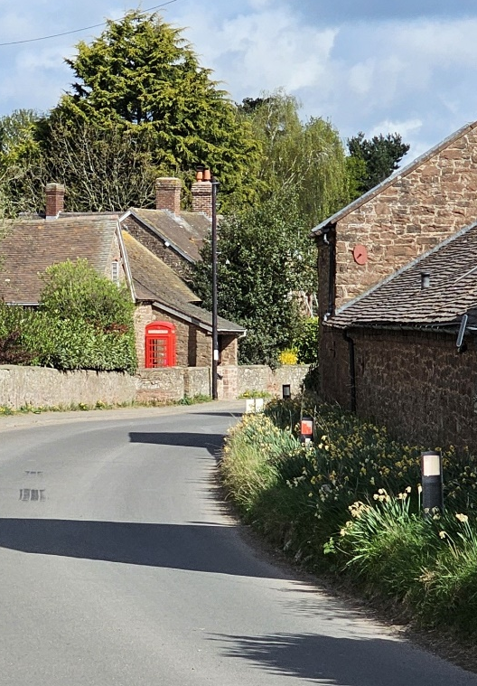
NEWS FROM PITCHFORD VILLAGE HALL
Breakfast Butties
Our first ‘breakfast butties’ of the year back in March went off extremely well and a good turnout, along with a small group for the associated ‘walkies’, made the event a very pleasing success. We are planning yet another of these popular events on Saturday 28th June where we hope to host not only another group of satisfied locals who don’t have to cook breakfast that morning, but also another local stroll for anyone in the area. As usual, keep an eye out on the ABC and PVH Facebook sites for details nearer the time. We would, as always, like to thank all those who supported our previous breakfast events last
year and hope to see you again later in the year.
Shropshire Village Hall
Quiz League
The PVH Quiz Team recently competed in another round of the Shropshire Village Hall Quiz League. This was, in fact, the final round and was held at Rushbury where our team scored a magnificent 56 from a possible 72 to allow them to finish in the top half of the league for the season – their best ever result! Well done to them! While this is our ‘official’ team, there is always the room for a possible ‘B’ team to take part and if anyone is interested in forming a second team of four, do get in touch with us here at the Hall and we can point you in the right direction!
Pub Nights
Our next Pub Night on the 9th May will be extra special with a celebration of the 80th anniversary of VE Day. Please do come along and join in the nostalgia that Friday evening, where bunting, music from the 40’s along with video of life back in the Second World War, will add to the ambience. Also on offer will be a 1940’s food staple of corned beef hash which we will be selling to you for a nominal amount (so very cheap!!). We are also sending special invitations to those folk in the Parish who may remember these times first hand. If you do get a letter and haven’t yet responded and would like to come along, please could you reply asap? Equally, if you are of an age to remember VE Day first hand and have not received a letter (our ‘database’ almost certainly will not be complete!), please do contact Chris Jones whose details are at the end of this article. It would be very special to see you there and for other younger folk in the area to hear any stories about life back in those times at first-hand! Please note the bar will, as usual, be ‘cash only’, but sadly we will be charging 2020’s prices and not those of the 1940’s!! Again, details of this will be publicised through the Facebook sites.
WiFi
You wouldn’t believe the problems we have had in getting BT to supply us with WiFi at the Hall, but we think we are winning – albeit very slowly – and this may be in place sometime in May we hope. Another facility for potential users of the Hall to enjoy!
PVH Committee
We are really pleased to let you know that Jeremy Lowe has taken the plunge and become a full member of our committee, and we welcome him wholeheartedly!
Please do read the separate article in this newsletter regarding volunteering at the Hall.
Hiring of the Hall
The Village Hall is your facility and is available for hire and at extremely competitive rates. Currently, prices start from:
Children’s parties: £30
Meetings: £20
Other bookings: £40 and £60 for
events over 6 hours
Should you wish to hire the hall for
your own use, then please contact
Mike Price.
Mike Price (Chairman):
email: price622@btinternet.com
mobile: 07740 067955
Chris Jones (Secretary):
email: csjay@btinternet.com
mobile: 07538 744807
Jeanette Reaney (Tote Organiser):
email: jeanettereaney@hotmail.com
mobile: 07971 780963
John Glover (PVH Committee)
NEWS FROM LONGNOR SCHOOL
What a wonderful few weeks we have had at Longnor Primary School. We are really enjoying seeing all the signs of Spring around the grounds and
enjoying the sunshine for outdoor learning and sports.
Our Eagles class enjoyed a spectacular residential week at Arthog Educational Centre in Wales. They took part in rock climbing, abseiling, gorge walking and canoeing as well as many fun evening activities and were lucky to have sunshine every day. We are very
grateful to our staff for giving up so much of their time to allow our students this enriching experience.
Students across all age groups are currently taking part in the Shropshire Primary Half Marathon. They have run the first twelve miles at school and will
be completing the marathon at the West Mids Showground on Saturday 12th April.
We are very proud of our children’s commitment and hard work running round and round the school field!
Merlins and Kestrels class had a lovely visit to Shrewsbury in late March,
visiting Shrewsbury museum, the Dingle gardens and Pizza Express where
Kestrels class created their own pizzas. We were lucky again to have beautiful sunshine so were able to properly enjoy the historic streets and beautiful gardens of the town.
We are looking forward to our Easter service at the end of this term and the children are really enjoying practising their Easter songs ready to share with their families.
We continue to work together to inspire a lifelong love of learning.
The Parish Council has recently arranged for the telephone boxes in Acton Burnell and Pitchford to be given a new coat of paint. Now looking very smart!

Slide 6
PARISH COUNCIL NEWS
The Council met on 11th March. Papers and minutes are available at www.actonburnellparishcouncil.org.uk/meetings
The main items discussed along with developments since the meeting are as follow.
Following some chasing by Cllr. Ball, the drains in Ruckley have been jetted and this seems to have improved the issues with flooding. A representative from Shropshire Council has undertaken a site visit and made some suggestions on ways residents could help to alleviate issues. The Council are also looking into whether the outflow could be improved and at more regular jetting in the meantime.
A mirror has finally been installed at the exit from Frodesley village. However, the work on the 30mph limit for Frodesley, rationalisation of signage following the village gateway installation and 30mph roundels is now planned for the 25/26 year. Hopefully this will go ahead soon. It was noted that the Frodesley mirror is only a single one facing back towards Acton Burnell. A second mirror is required to show traffic coming from the Longnor direction and this has been requested.
Recent repairs to potholes and collapsed verges were noted as being of very poor quality and only lasting days or a few weeks. This was reported and some improved repairs have since been made on the Acton Burnell to Pitchford road. The road between Ruckley and Causeway Wood is now in a very poor state
and has been reported to
Shropshire Council.
Once again, everyone is urged to continue to report issues with potholes and eroded verges via the “Fix my Street” website.
The Council agreed to fund grass cutting on the old Roman Road and will continue to pursue options to keep local footpaths from becoming overgrown. It was agreed to put together a scope of work document noting those sections which require regular clearing – probably only once or twice a year. This will provide a plan for volunteer groups and/or contract clearing.
The case regarding the Pitchford to Golding Lane remains with Shropshire Council although the independent report and draft order was completed over a year ago and this, along with any objections, have been ready to submit to the Secretary of State. Shropshire Council will be approached again and if there is still no progress a letter of complaint will be sent to the Secretary of State.
The possibility of establishing a safe footpath from Acton Burnell to Pitchford is still being pursued.
Tracy Johnson, Parish Councillor for Pitchford, advised that she is standing down and would not be seeking re-election in May. Tracy has been very active in the council, particularly in providing input to work on rights of way and sterling work with the Jubilee Picnic. She will be missed but will no doubt continue to be active in the community.
The Council noted the passing of Acton Burnell resident Mrs Muriel Perks and wished to send its sympathy to her family and highlight the amount of work she did for the Acton Burnell Community including chairing the Parish Council, running the shop and campaigning to save the school from closure.
The Annual Parish (Community) meeting is set for Tuesday 20th May at 7:30 at Pitchford Village Hall. Following the success of the event last year, refreshments will be provided and all residents are welcome to attend. A number of speakers have been arranged and
we are hoping for another good turnout and some useful comments and ideas.
The next Parish Council Meeting is set for Tuesday May 13th at Pitchford Village Hall, starting at 19:30.
SHROPSHIRE COUNCIL SCORES ‘GOOD’ IN CARE QUALITY INSPECTION
Shropshire Council has announced that its Adult Social Care services have been rated ‘Good’ following an assessment by the Care Quality Commission (CQC).
In the report published on Friday
28 February, the CQC concluded that ‘evidence shows a good standard’ for
the council’s adult social care service, highlighting several areas where Shropshire Council is excelling in serving its community. The CQC report highlighted many areas of good practice and rated the service good in:
Care provision, integration and continuity
Safeguarding
Partnerships and communities
Governance, management and sustainability
Learning improvement and innovation.
The purpose of the CQC assessments is to understand the performance of Local Authorities and to assure CQC and the Department of Health and Social Care about the quality of care in an area and consider whether any improvements may be required.
The council was pleased to hear from inspectors who said that many people across the county reported ‘positive experiences’ with Shropshire’s adult social care services, noting ‘improvements in their independence’ due to the care and support they received. Inspectors also heard positive feedback from unpaid carers and staff and described staff as ‘committed and passionate.’
The CQC report identified many strengths within adult social care services, saying:
The local authority had a good understanding of the diverse needs and make up the local population.
There was a clear focus on promoting independence, and work to prevent, delay or reduce the need for care and support.
The local authority has clear and effective governance, management, and accountability arrangements. This provided oversight of the delivery of their Care Act duties.
The council has strong relationships with housing, health, public health, and community partners. Inspectors recognised the collaboration in aligning priorities, integrating care systems, and improving care quality and accessibility, ensuring that people can live independently and receive the necessary support within their local communities.

Slide 7
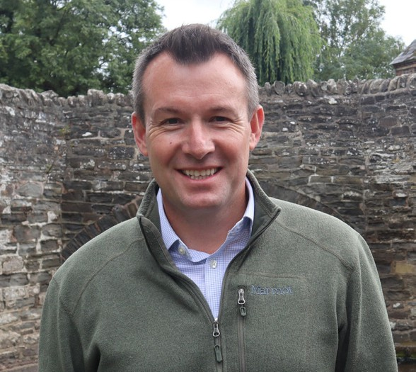
Letter from Westminster
The increased costs being faced by everyone this April is a serious
challenge. I continue to raise with the Government the need to
support our hospitality businesses with a VAT cut and warn about
the dangers of tax increases on businesses. Many constituents
have also got in touch with me to explain how the welfare reforms
will affect them and their loved ones. I am launching a survey to
collect more views and pass them on to Ministers. We must
encourage people back to work while properly supporting those
who are unable to do so.
I spoke with the BBC about the campaign being run by local constituent Rachel Baker on family access to mortuaries. Rachel’s son, Joe, an accomplished aircraft engineer, tragically lost his life in a road traffic accident in November 2023. The family were denied access to his body for 10 days despite many desperate appeals. I am supporting Rachel’s heroic campaign and petition to improve the support offered to families in this most tragic of circumstances. After my initial enquiry, Ministers said there were no plans to change these rules, so I have requested a meeting with Ministers to explain the hurt this policy causes families.
Potholes blight rural areas like South Shropshire, costing the owners of damaged vehicles almost £400 each year. I am calling on Ministers to stand by the previously announced investment for Shropshire. It would equip the Council with the certainty needed to plan ahead. I am also urging residents who have experienced potholes and other problems with road surfaces to tell me about it as part of my new Pothole Patrol initiative.
Farmers are the backbone of our rural economy. So, I was delighted to welcome Shadow Farming Minister Robbie Moore MP to South Shropshire recently. We met with local farmers and representatives from the National Farmers Union at a third-generation family farm near Craven Arms. We discussed the impact of government policies and how farmer confidence can be restored. Shropshire has the highest number of farms per country in England, so this is an issue that is very important for our rural economy.
I have been visiting many local schools recently, from Stottesdon to Newcastle on Clun to Dorrington and Clee Hill. It is really great to meet with students who always have excellent questions. One issue that comes up often are financial constraints. In a recent announcement South Shropshire missed out on funding for nursery provision within primary schools. This is a significant rural challenge that I will be raising on behalf of constituents.
It was great to visit Clickingmad, a digital services company celebrating their 25th anniversary, and launch their '25 Acts of Kindness in 2025' initiative in Bridgnorth. Our small businesses are a cherished part of South Shropshire, so I was also delighted to recognise Ludlow Nutrition as the winner of my Small Business Awards, alongside 85 other nominated businesses. I continue to encourage businesses to take part in my small business survey.
Stuart Anderson MP
CONTACTING YOUR MP
Contact details for MP Stuart Anderson have changed and he can now be contacted at 75a High Street, Bridgnorth, WV16 4DX, by telephone on 01746 555025, or by email at stuart.anderson.mp@parliament.uk

Slide 8

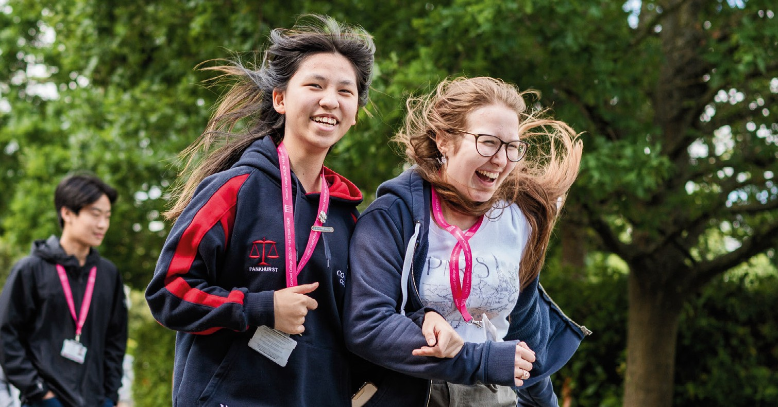














Are you worried about the current
economic climate?
Do you know how this is affecting your pension, savings or investments?
Do you know if any changes
are needed?
For a free review to discuss, why not book a free initial consultation with a locally based Independent Financial Adviser with over 25 years experience.
Please contact Keith Croft on 07815 075793 or email keith@croftandoakes.co.uk to arrange your appointment.
www.croftandoakes.co.uk
Registered office
Suite 7 Business Development Centre, Stafford Park 4, Telford, TF3 3BA
Want to advertise in this space?
For more information please
contact
Rachel Johnson on
07891 945704 or email villageviewsadvertising@ outlook.com
Agricultural Merchants and Garden Machinery Sales, Service and Repair
Husqvarna Automower® • Specialist Animal feed Garden Tools and Compost • Calor Gas Cylinders Animal Health Products • Fencing Materials Equine Supplies • Shavings • Coal
and much much more
Free local Delivery Service | Open to the Public
Unit 85, Condover Ind. Estate, Shrewsbury SY5 7NH
01743 718955 | www.acefarmsupplies.co.uk enquiries@acefarmsupplies.co.uk
Mon-Fri 8.00am – 5.00pm | Sat 8.00am – 12 noon
NETLEY
BOARDING KENNELS AND CATTERY
Nice rural location Heated kennels with outside runs
Friendly family run business
Also offering doggy daycare
NETLEY KENNELS AND CATTERY
Lower Netley Farm, Dorrington, Shrewsbury SY5 7JY
07803240207 | 01743 623176
Hardwood Logs
Free local delivery Seasoned, Barn Stored & Kiln Dried
Visit our website for our full
range of logs, coal and kindling
01746 785606
www.logs2yourdoor.co.uk

